Slide 1

Sales report of café shop
Name – S.K.M.JUNAID
College Name – RAGHU Engineering College

Slide 2

PROBLEM STATEMENT
Analyzing café shop sales from January to June by comparing sales based on different product types and product categories and finding the highest sales based on store location.
Dataset is taken from kaggle

Slide 3
Project Description
The dataset contains the columns product categories, types of products, unit price, and transaction quantity of each product type.
In project used Power BI to visualize and compare values to get a better understanding of the data and sales done by the shop. By the visualizations, we compared transaction quantities of different products…..
Observation –
observed that the Hell’s Kitchen shop has generated more revenue compared to the two other shops. The highest selling product type is coffee followed by tea and bakery items. Flavours have the least number of sales
The highest sales were done in the months of May and June

Slide 4

WHO ARE THE END USERS?
Café Shop owner
Analysts

Slide 5

Technology Used
POWER BI -
used for visualizing the data

Slide 6
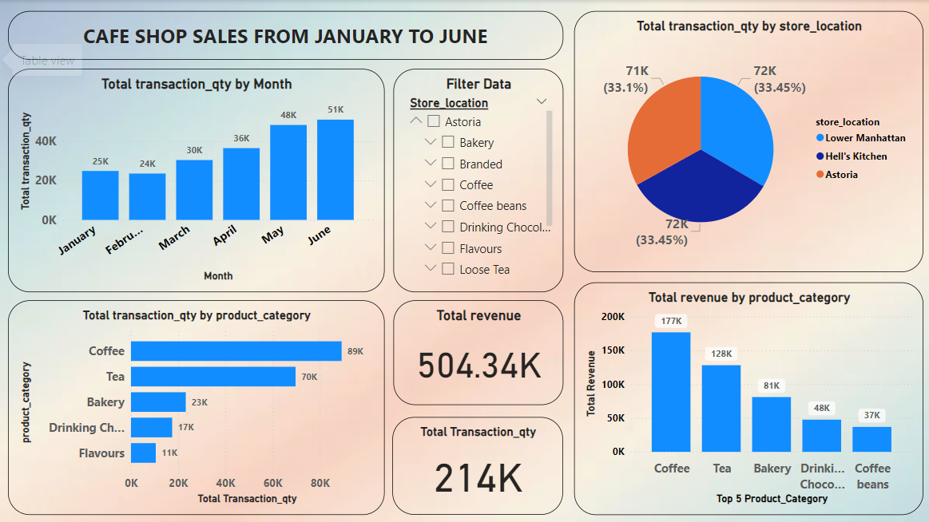
RESULTS
Google drive link

Slide 7
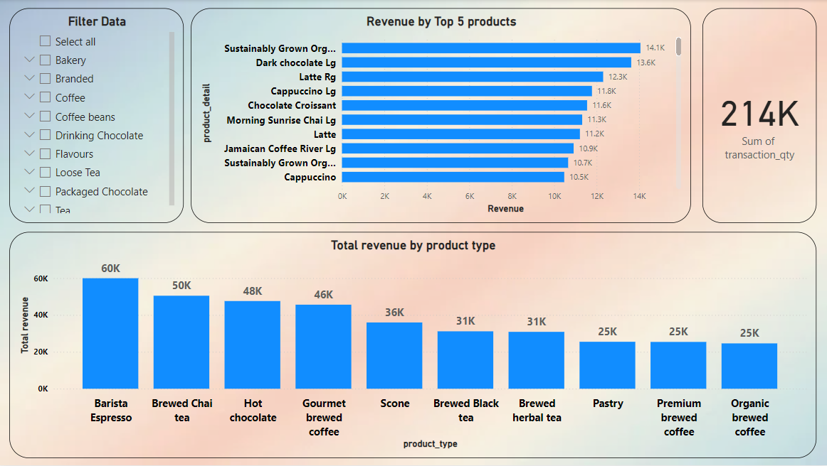
RESULTS

Slide 8
Thank you
Use the given google drive link to download dashboard and dataset.
Google drive link
.
.

